Slide 1




HOPE TO SKILL
Lecture 27
Convolutional
Neural Network(CNN)
Artificial Intelligence Advance Course

Slide 2


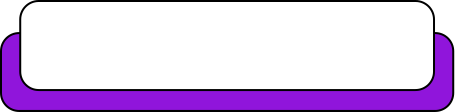
Dedicated to my late Teacher, a beacon of Knowledge.
Your Guidance shaped me; now I shape others through
a free course.
YOUR LEGACY LIVES ON!

Slide 3




AI INSTRUCTORS
Dr.Irfan Malik
Dr.Sheraz Naseer
Dr.Shazia Saqib
M.Haris Tariq

Slide 4



Previous Lecture Topics
01
Artificial Neural Networks
02
Hyperparameters
03
Learning Rate
04
Epochs & Batch Size
05
Activation Functions
06
Forward/Back Propagation

Slide 5
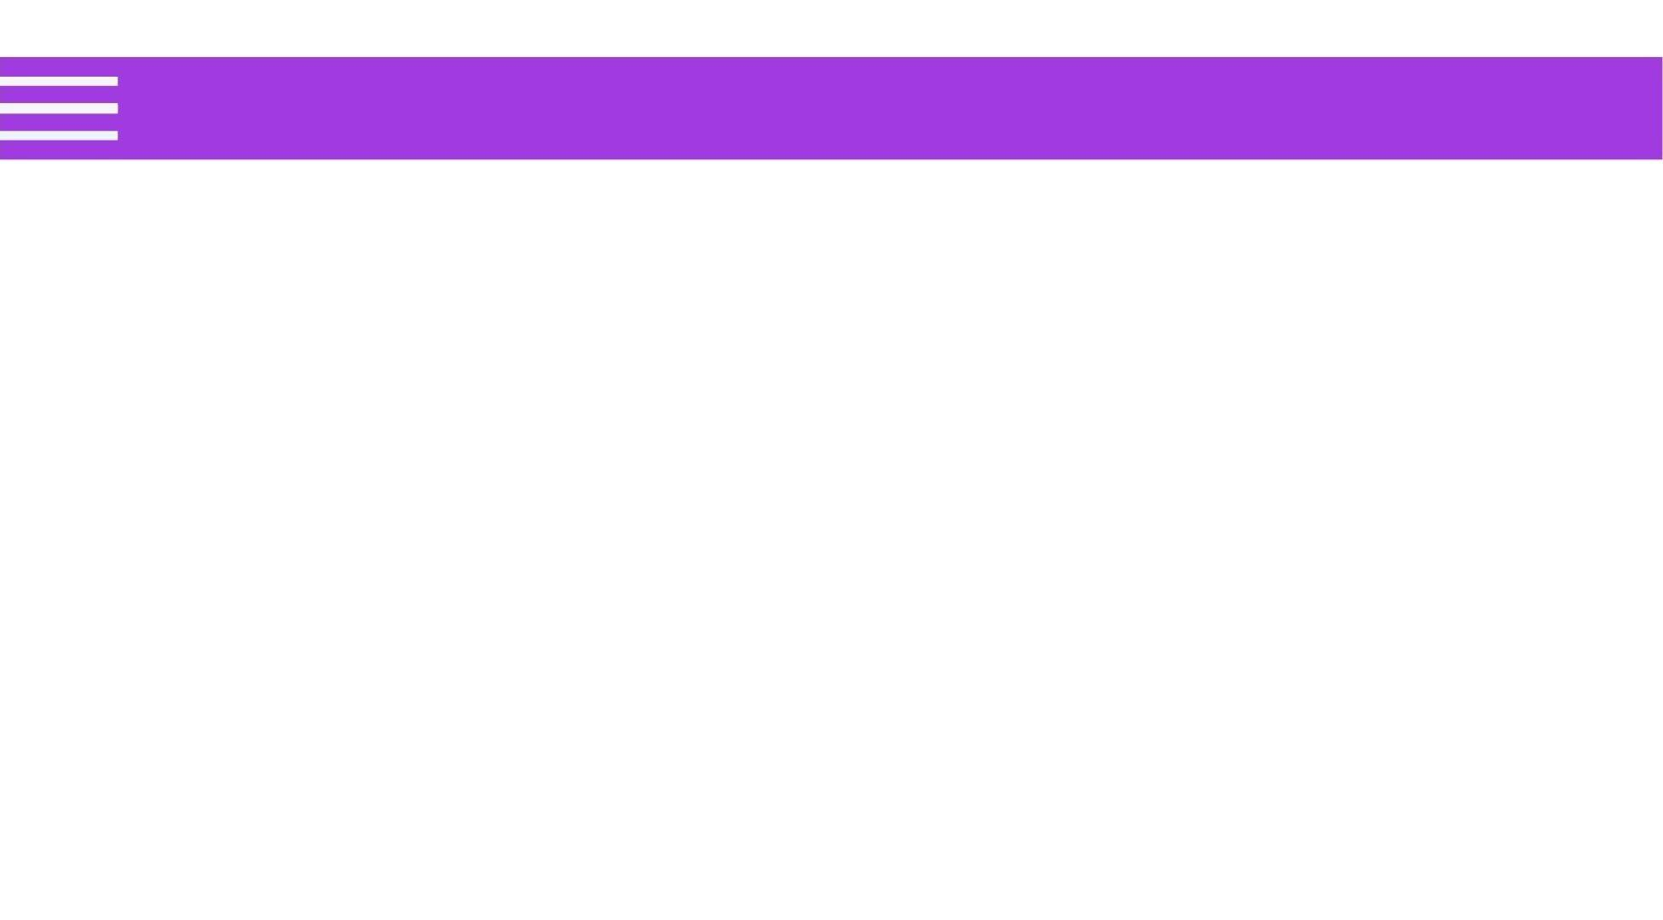

Lecture Objectives
Understand the basic architecture of CNNs
Learn about how CNNs greatly improve computer vision tasks

Slide 6
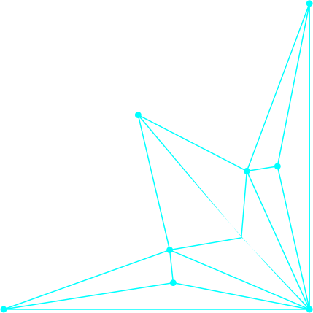
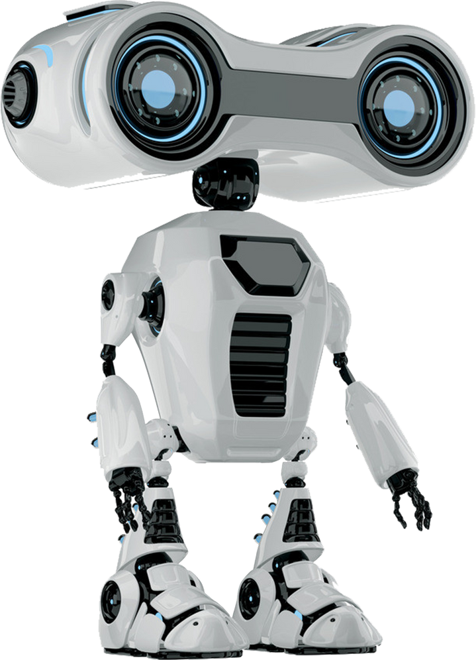

Outline
Limitations of simple Neural Network
Introduction to Convolutional Neural Networks (CNN)
Basics for CNN
Images and features
Kernel
Convolution
Number of filters, Depth
Stride
Pooling
Padding
Receptive Field

Slide 7

Limitations in Simple Neural Networks
Pixel Inequality
High Dimensionality
Limited Feature
Extraction

Slide 8
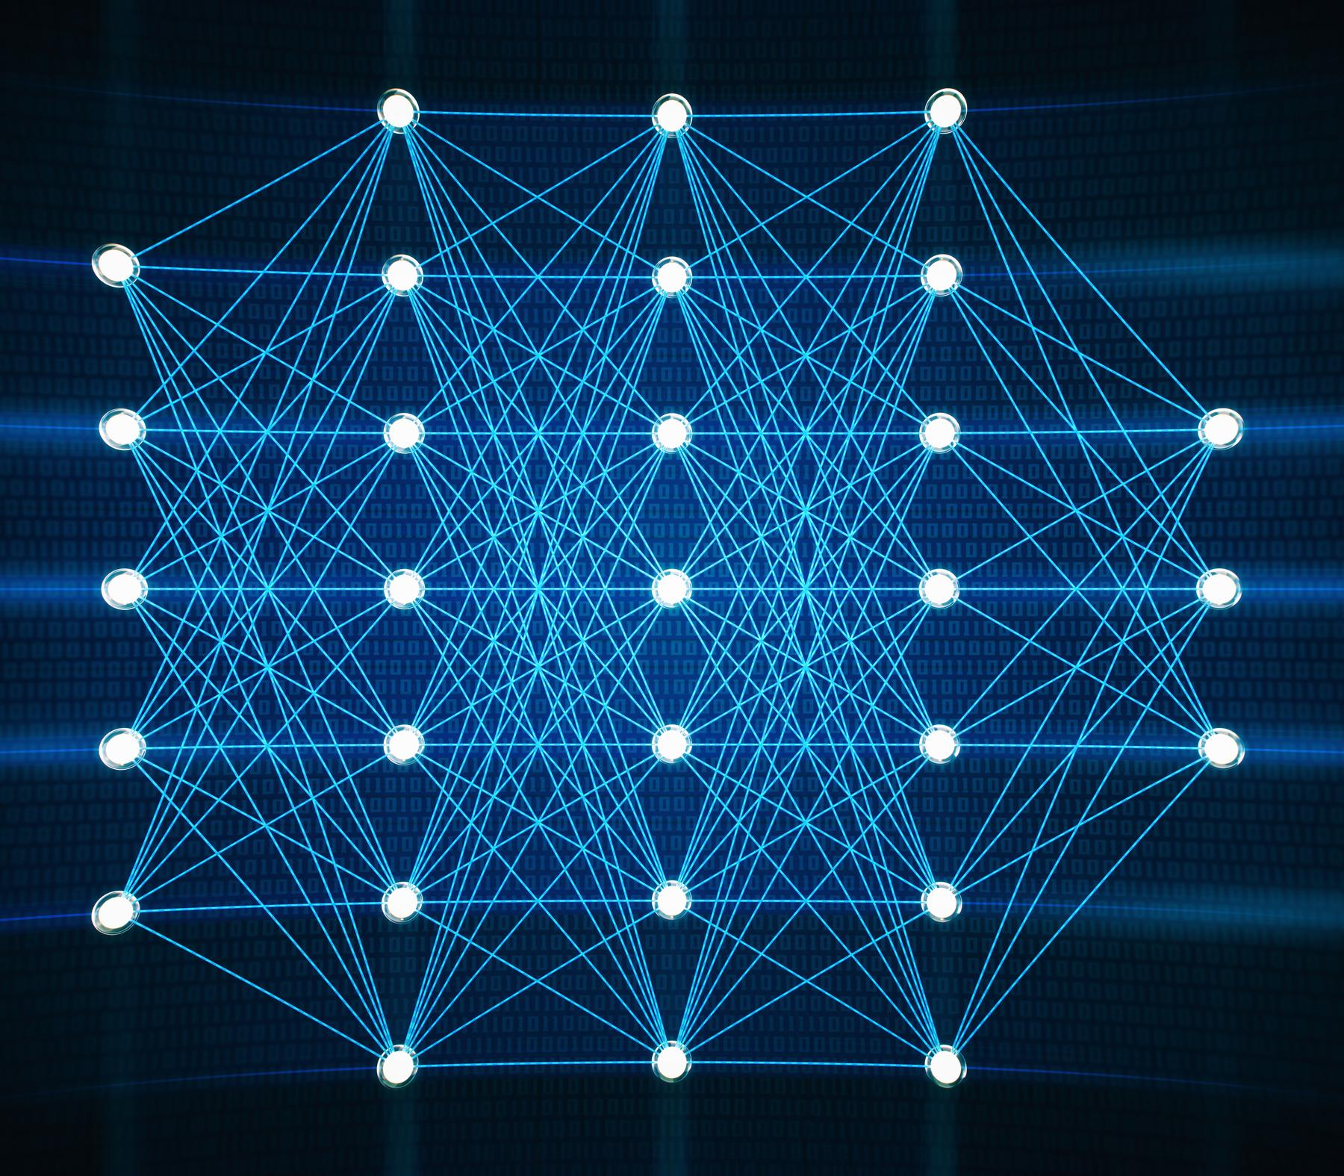

Limitations in Simple Neural Networks
Large Computational Requirements
Pixel Equality and Spatial Relationships
Inability to Handle Sequential Data

Slide 9
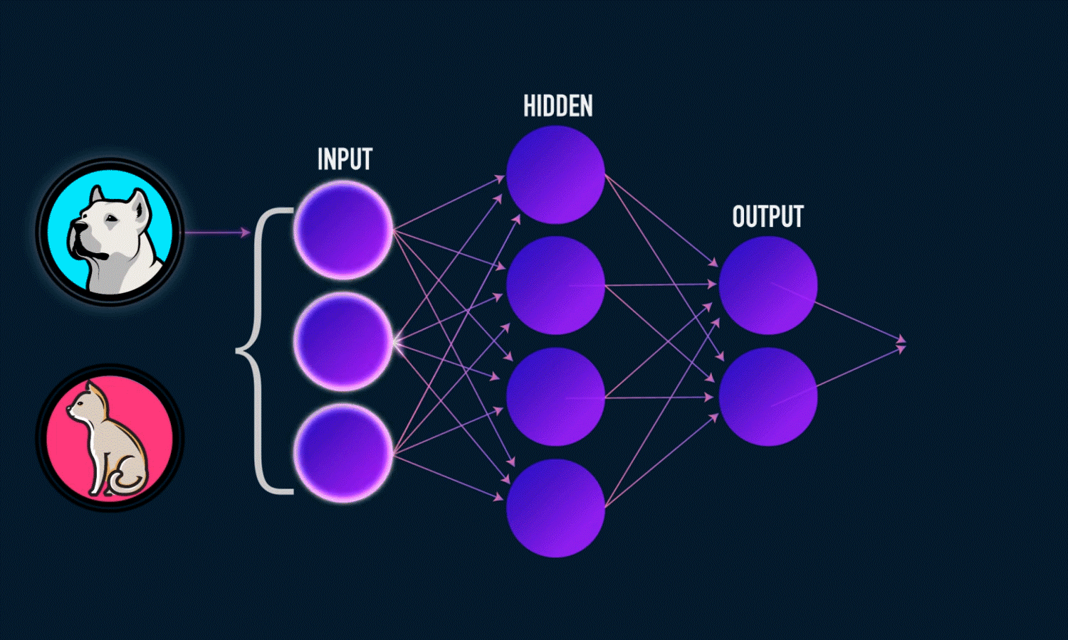
Pixel Inequality
Simple neural networks treat all pixels
in an image equally, regardless of their
spatial relationships or positions.
This means they cannot effectively capture the local patterns and structures in images.

Slide 10
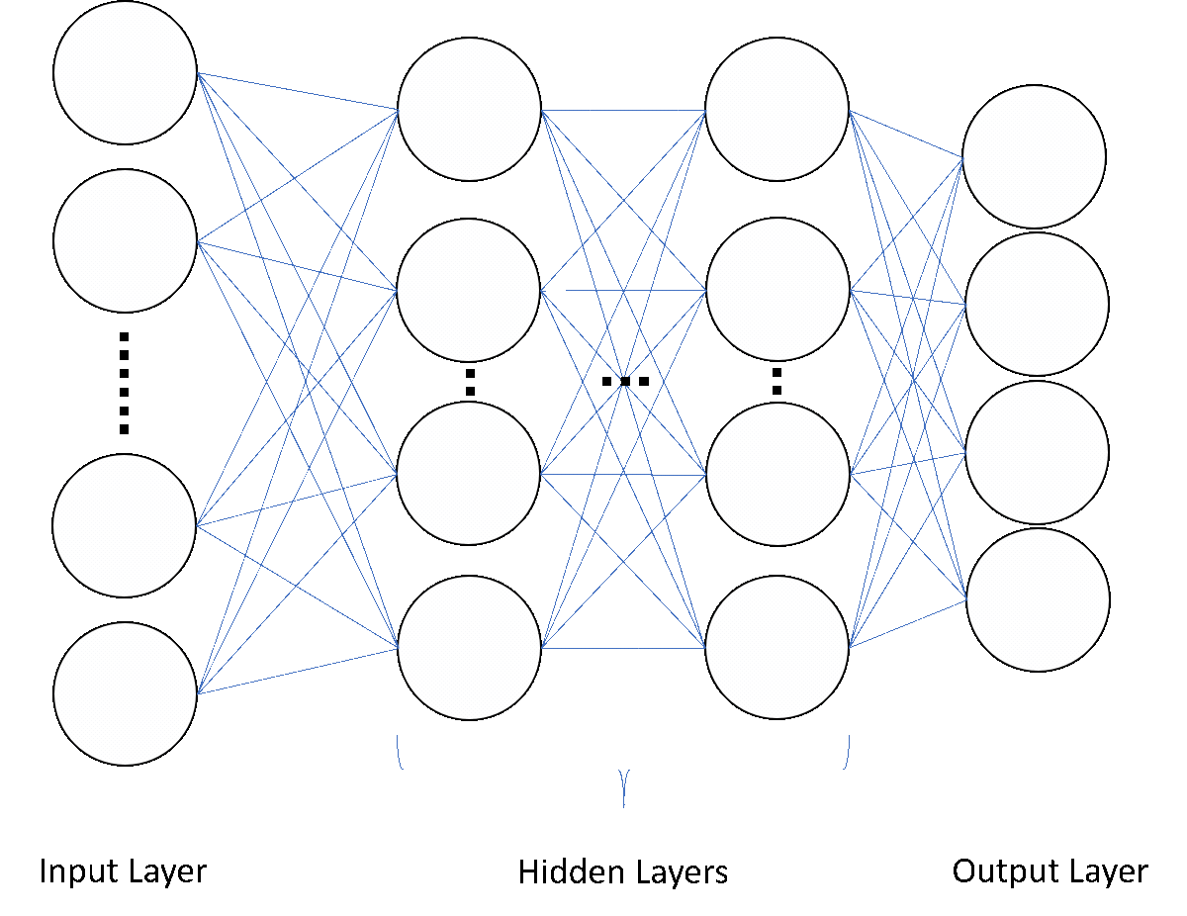
Pixel Inequality

Slide 11
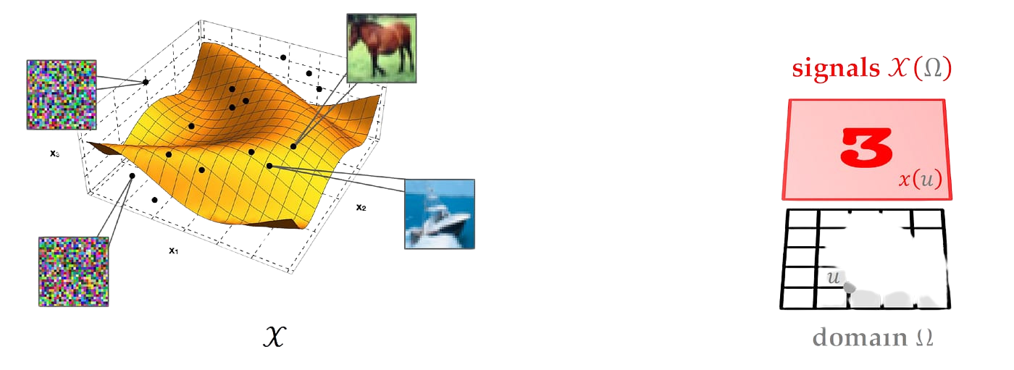
High Dimensionality
High dimensionality means that as the image size increases, the number of pixels grows exponentially, greatly increasing the weights and model complexity.
Example:
28x28 image = 784px 256x256 image = 65,536 px

Slide 12
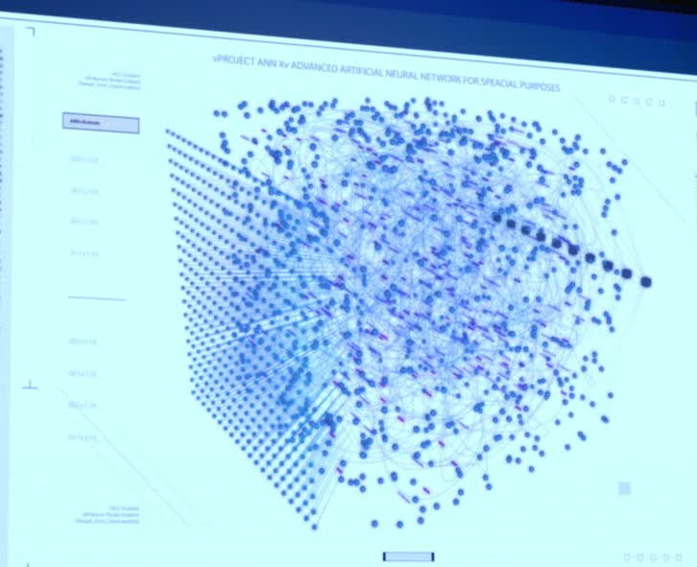
Large Computational Requirements
Larger number of weight require more computational resources to train.

Slide 13

Large Computational Requirements
Requires significant time investment.
High computational needs make simple NNs less efficient for practical use.

Slide 14
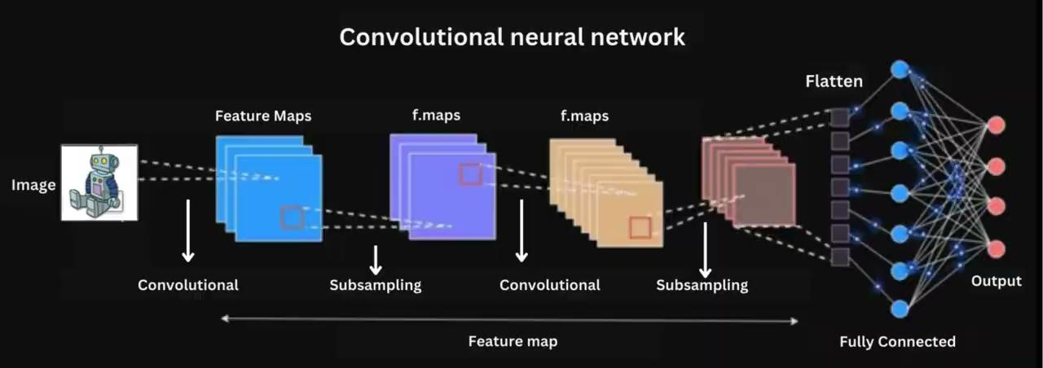
Large Computational Requirements
Introduction to Convolutional Neural Network (CNN)
CNNs are a type of Neural Networks
inspired by how our brain processes
visual information.
They're specialized for understanding
images, making them powerful tools in
image analysis, recognition, and more.
Requires significant time investment.
High computational needs make simple NNs less efficient for practical use.

Slide 15
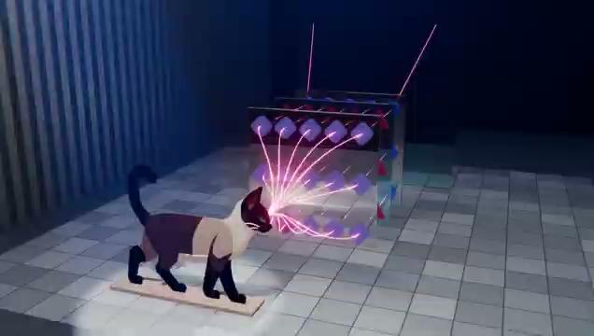
How CNN Work on Image

Slide 16
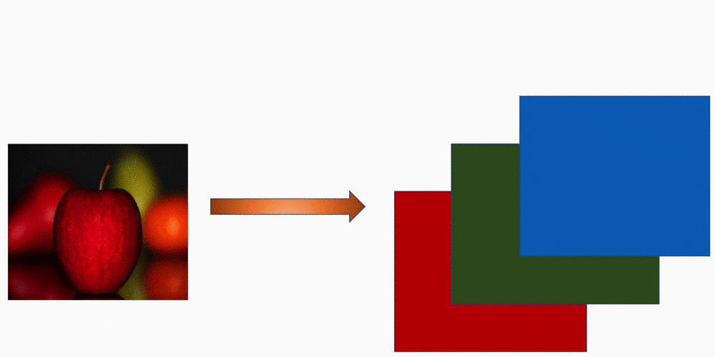
Images in Computers
Understanding image channels (RGB)

Slide 17
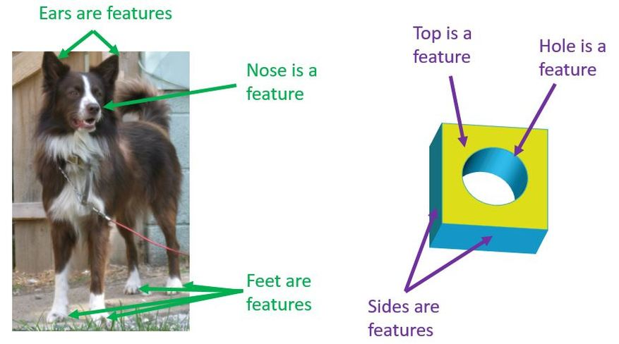
Features for Images
Images are full of important parts called features.
Features can be edges, textures, shapes, or even faces.

Slide 18
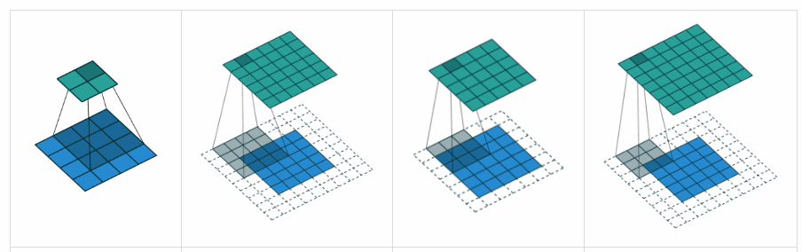
Convolutional Layer Explained
Convolution Operation:
Applies filters to the input image to
create feature maps.
Filters are small matrices that slide
over the input image and detect patterns.

Slide 19
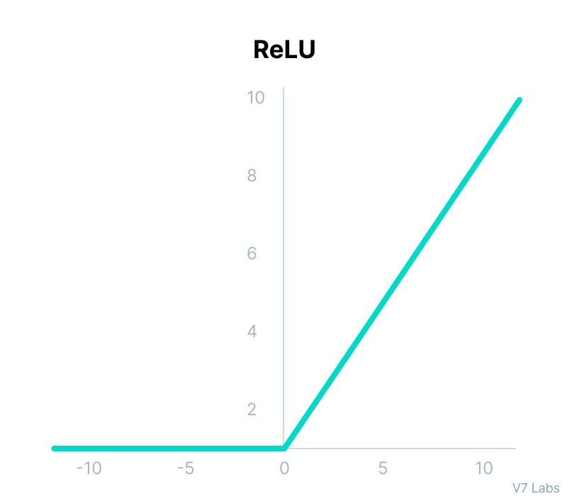
Convolutional Layer Explained
Activation Function:
Usually ReLU (Rectified Linear Unit),
which introduces non-linearity.

Slide 20
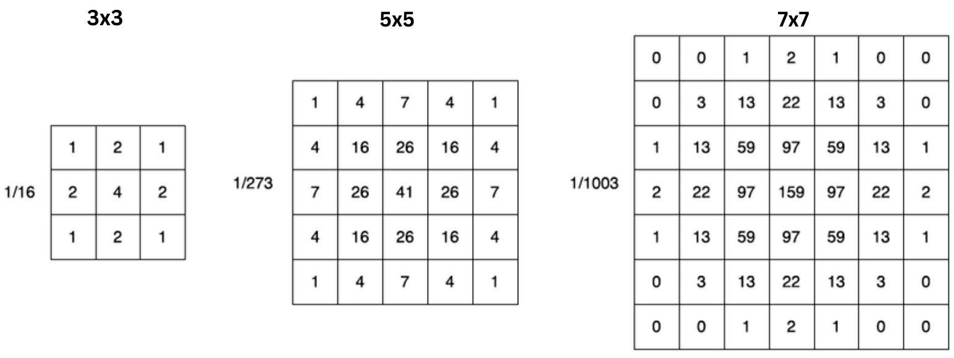
Kernel
Kernels in CNNs are usually small 2D matrices used for feature extraction through convolution operations on input data, typically with dimensions in odd numbers.

Slide 21

Convolution
At each position, the kernel performs el﻿ement-wise multiplication with the corresponding part of the input data it covers.
Then, the results of these multiplications are summed up to produce a single output pixel.

Slide 22

Convolution
Convolution is like a special way of looking at data. It's a mathematical operation that brings out patterns.

Slide 23

Convolutional Kernels
The kernel is that matrix which is swiped, or more precisely convolved across a single channel of the input Image.
Convolution on an (h, w, in_dims) image gives an (h', w', out_dims) feature map.

Slide 24

Overall Structure of a CNN
Convolutional Layer:
Detects features like edges, textures, and patterns in images.

Slide 25
Overall Structure of a CNN
Pooling Layer:
Reduces the spatial dimensions
of the image, preserving important features while reducing computational load.

Slide 26
Overall Structure of a CNN
Fully Connected Layer:
Combines all detected features to make the final prediction.

Slide 27
Overall Structure of a CNN

Slide 28
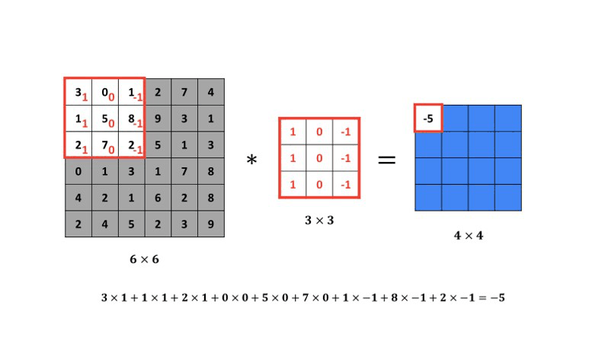
Vertical Edge Detection

Slide 29

Previous Lec: 27
click Here
Next Lec: 29
Quiz
click Here

Slide 30
SUMMARY
Limitations in Simple Neural Networks
Introduction to Convolutional Neural Network (CNN)
Features for Images
Convolutional Layer Explained
Kernel
Overall Structure of a CNN
Vertical Edge Detection

